Slide 1
Data Privacy Collection, Monetization and Ramifications
Aaron Dawson, Shengjia He, Tom Lancaster, & Danniel Sotelo

Slide 2
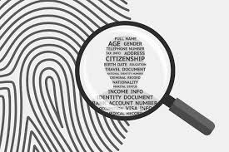
What is “data”?
Data is all personal information that is used to identify a customer or person
Common Types of Personal Data is:
Email address
Phone number
Credit card information
Birthdate
Social security number

Slide 3
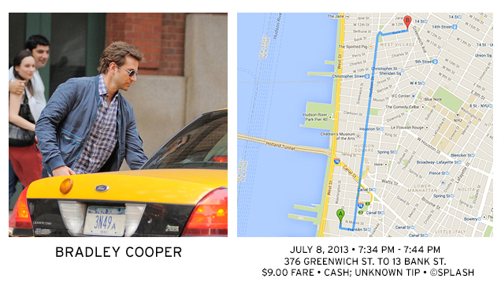
Helpful Business Insights vs. Invasion of Privacy

Slide 4
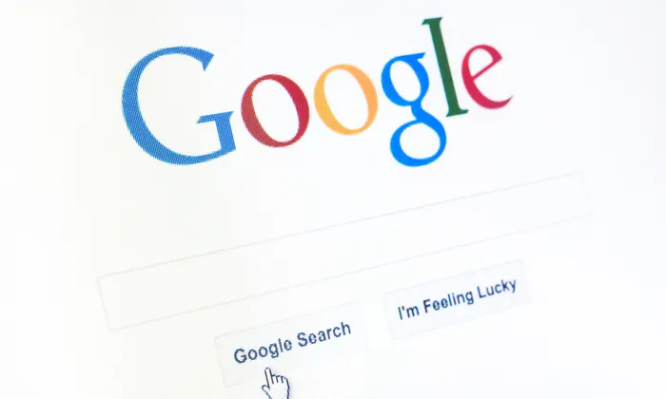
Thought Experiment
Think of your last 5-10 Google searches
What does this reveal about you?
Would you want other people knowing this information?

Slide 5
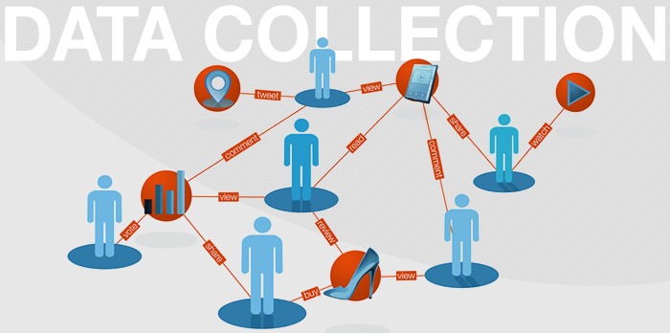

Slide 6
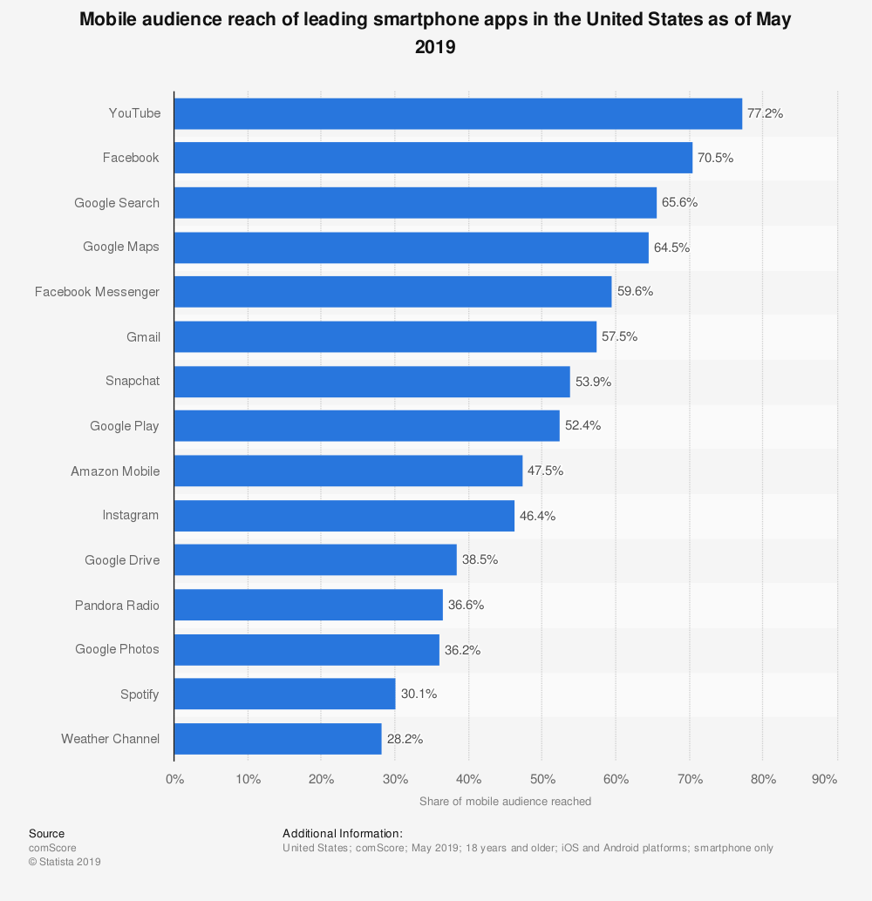
YouTube
Facebook
Google Search
Google Maps
Facebook Messengers
Gmail
Snapchat
Google Play
Amazon Mobile
Instagram
Google Drive
Pandora Radio
Google Photos
Spotify
Weather Channel

Slide 7
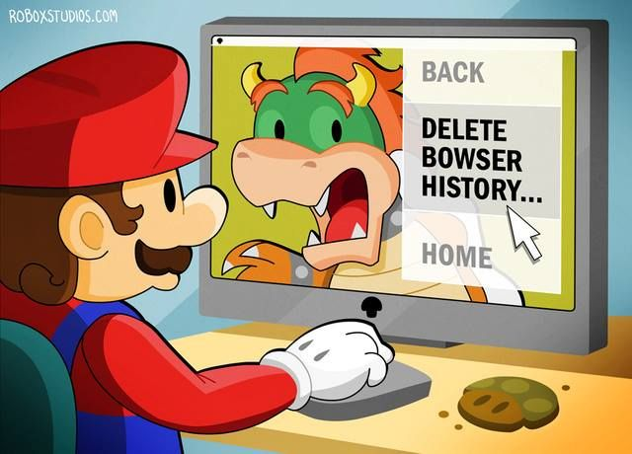
What is collected?
Browser
IP Address
Browser Name
Computer System Info http://webkay.robinlinus.com/
Clicks https://clickclickclick.click/
Unique Fingerprint? https://panopticlick.eff.org/

Slide 8
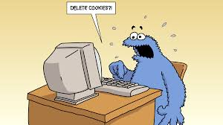
What is a cookie?
Each cookie is effectively a small lookup table containing pairs of (key, data) values - for example (firstname, John) (lastname, Smith). Once the cookie has been read by the code on the server or client computer, the data can be retrieved and used to customise the web page appropriately.

Slide 9

What is collected?
Facebook
Collects EVERYTHING!
https://www.facebook.com/about/privacy/update

Slide 10
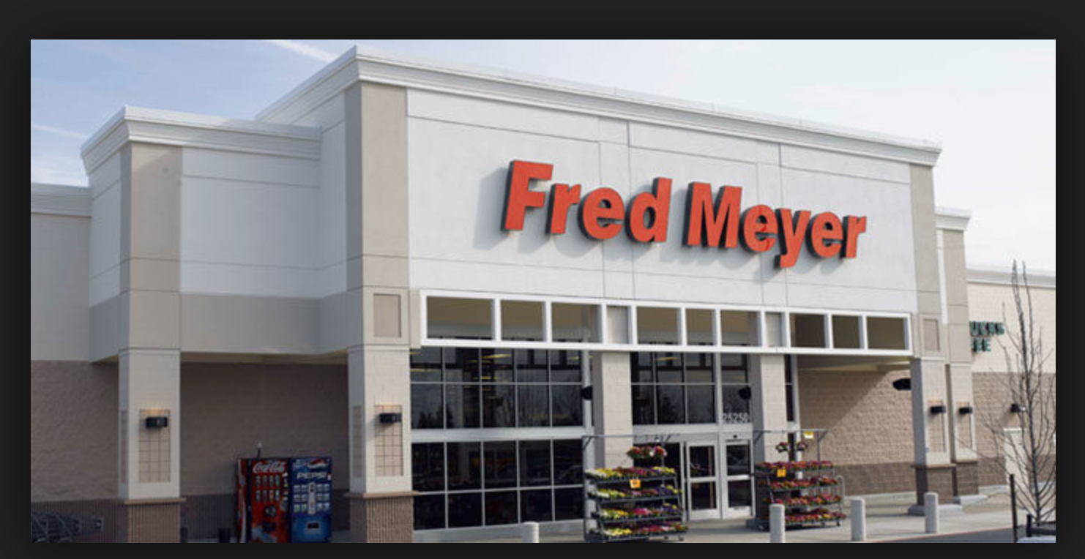
What data is collected?
The Fred Meyer:
Name, address, phone and email

Slide 11
What data is collected?
The Fred Meyer:
Name, address, phone and email
Communication and shopping preferences

Slide 12
What data is collected?
The Fred Meyer:
Name, address, phone and email
Communication and shopping preferences
Driver’s license number for certain types of sales and for ID verification

Slide 13
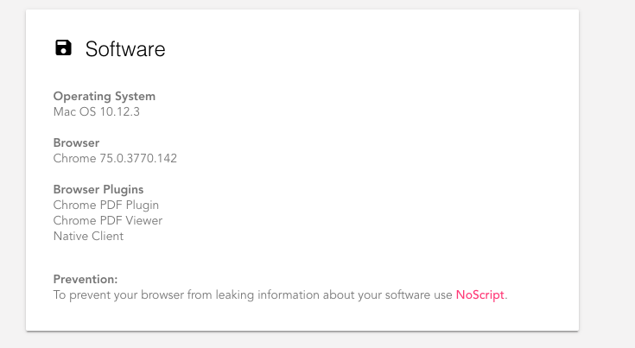
What data is collected?
The Fred Meyer: Cookies and other technology
Unique device or user ID

Slide 14
What data is collected?
The Fred Meyer: Cookies and other technology
Unique device or user ID
System and browser type

Slide 15
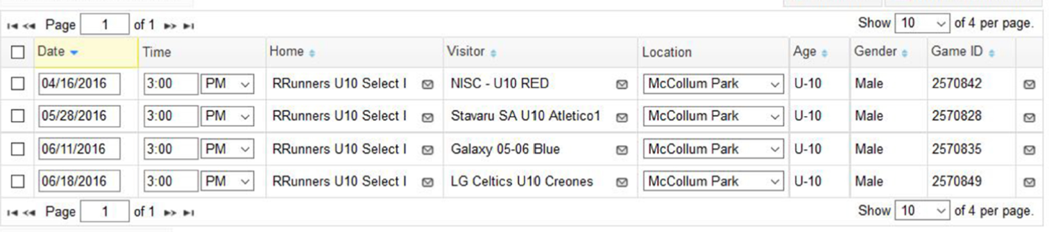
What data is collected?
The Fred Meyer: Cookies and other technology
Unique device or user ID
System and browser type
Dates, times and locations when actions take place

Slide 16
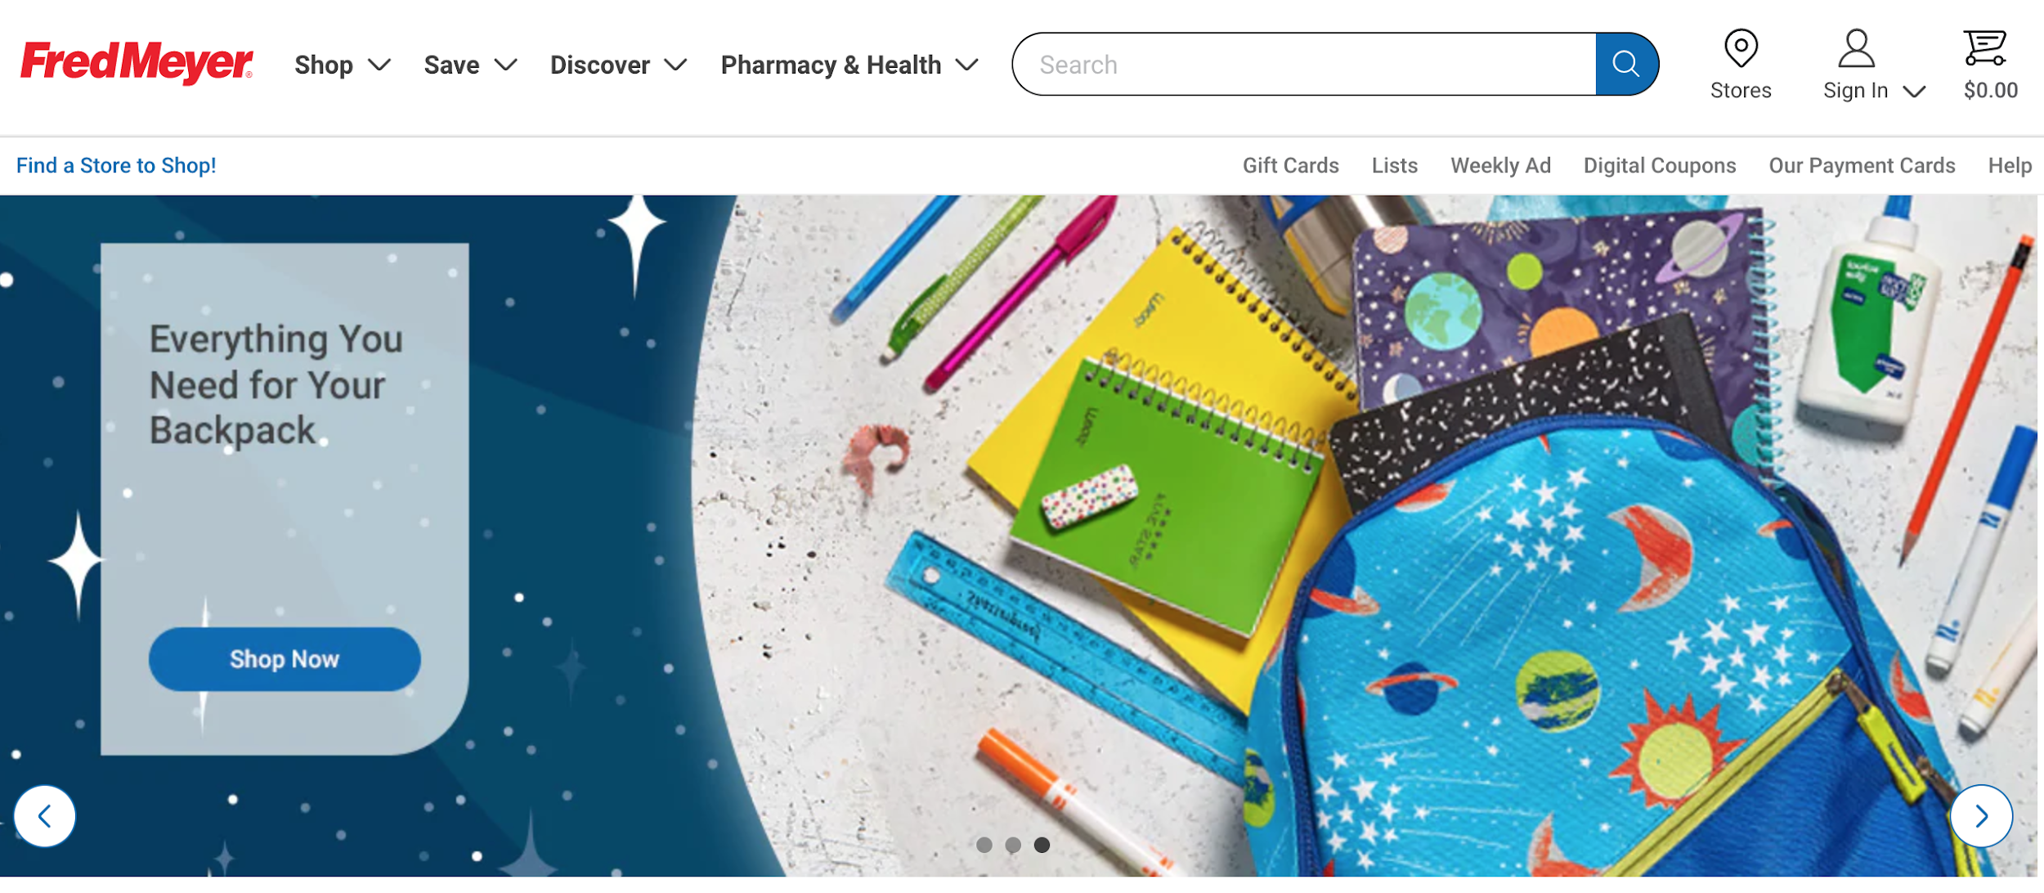

How is it collected?
The WIFI

Slide 17
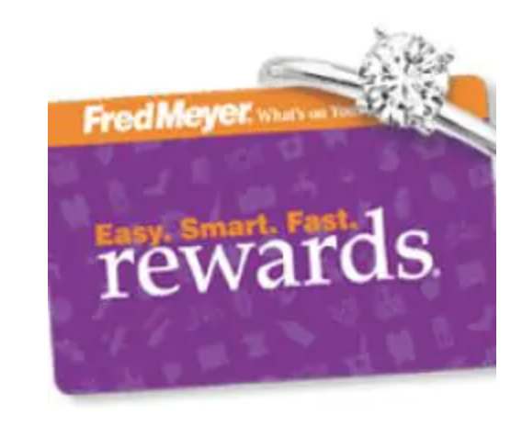
How is it collected?
The WIFI
Rewards card

Slide 18
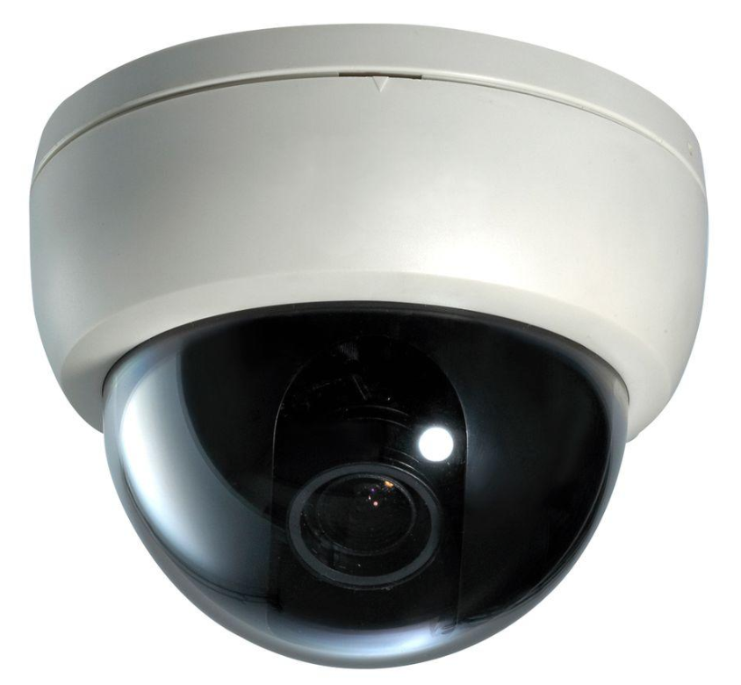
How is it collected?
The WIFI
Rewards card
Security camera

Slide 19
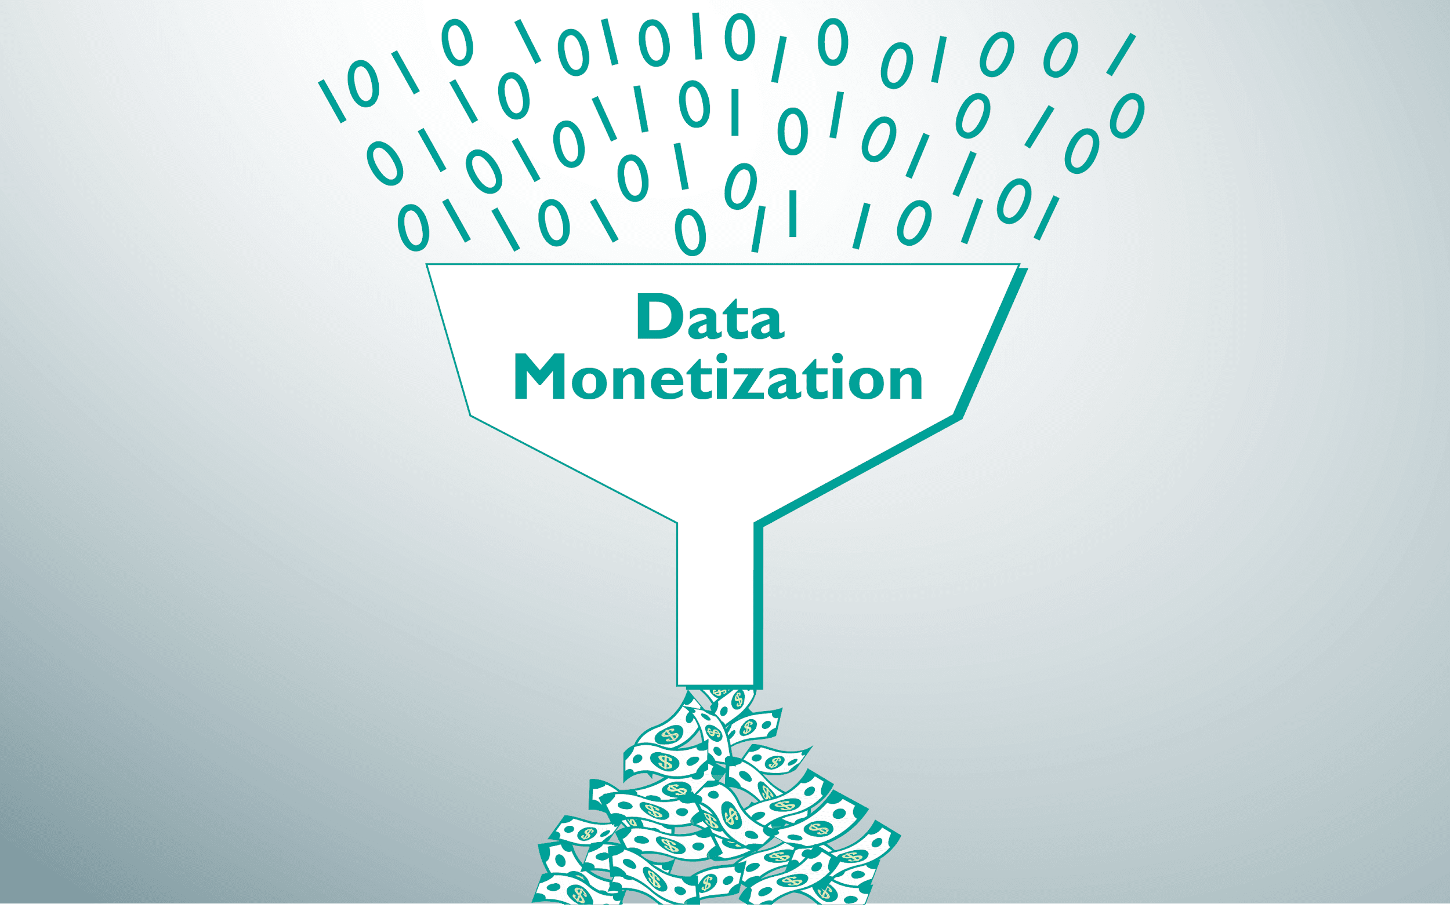
Monetization
monetize
mon·​e·​tize | \ ˈmä-nə-ˌtīz
...
3 : to utilize (something of value) as a source of profit
https://www.merriam-webster.com/dictionary/monetization

Slide 20
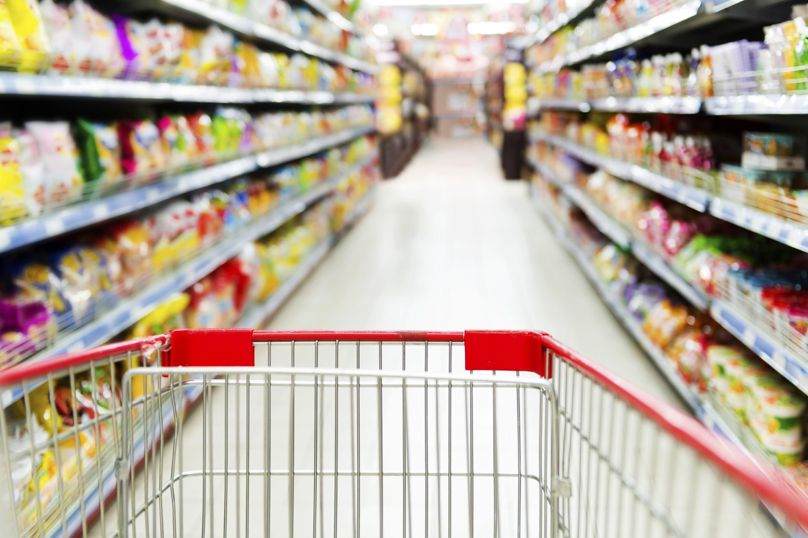
Monetization in stores
Reducing Cost
Improving internal processes
Minimizing churn
Increasing Revenue
Providing new products or services
Maximizing customer satisfaction

Slide 21
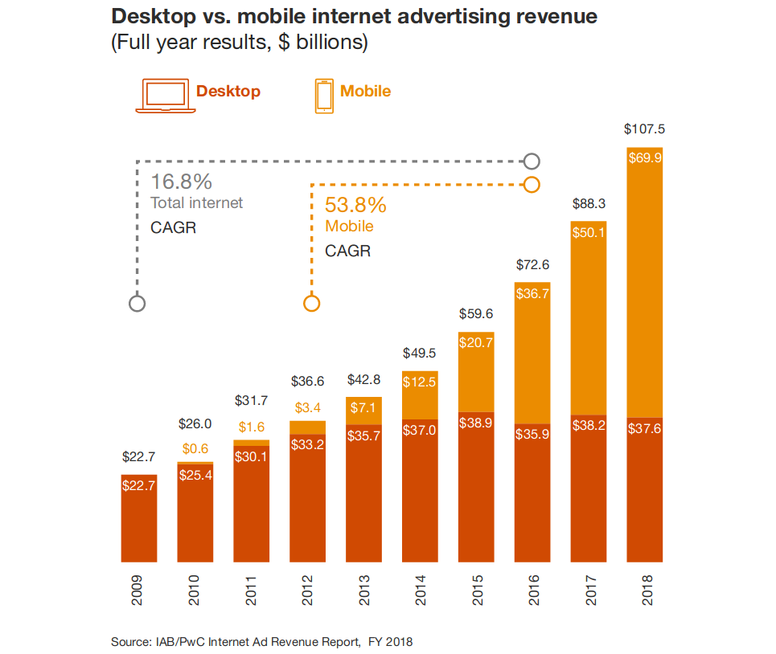
Monetization of app/online data
In 2018, Internet advertising revenues in the United States totaled $107.5 billion for the full year.
“Advertising revenues delivered on mobile devices totaled $69.9 billion in FY 2018”
mobile revenue makes up 65.1% of total
https://www.iab.com/wp-content/uploads/2019/05/Full-Year-2018-IAB-Internet-Advertising-Revenue-Report.pdf

Slide 22
Monetization of app/online data
“Companies are capitalizing on their trove of consumer data, including purchasing and browsing history, enabling advertisers to programmatically reach audiences in more effective ways”
-IAB Internet Advertising Revenue Report 2018

Slide 23
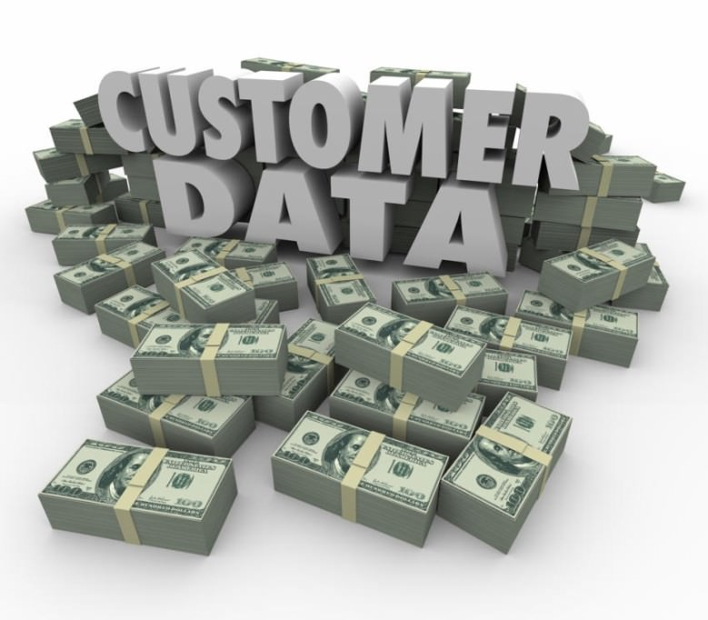
Monetization of app/online data
“Companies are capitalizing on their trove of consumer data, including purchasing and browsing history, enabling advertisers to programmatically reach audiences in more effective ways”
-IAB Internet Advertising Revenue Report 2018

Slide 24
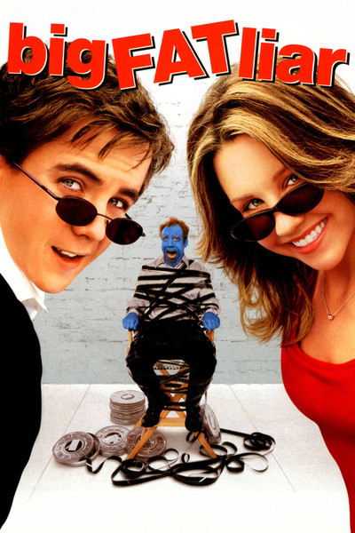
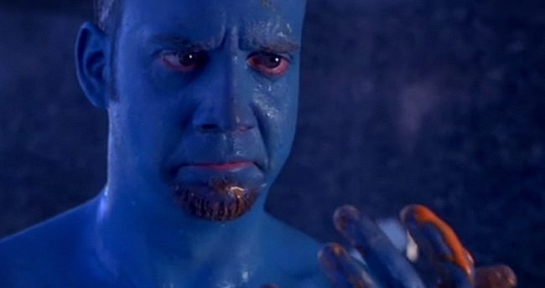
Ramifications of Exposed Data - Benign

Slide 25
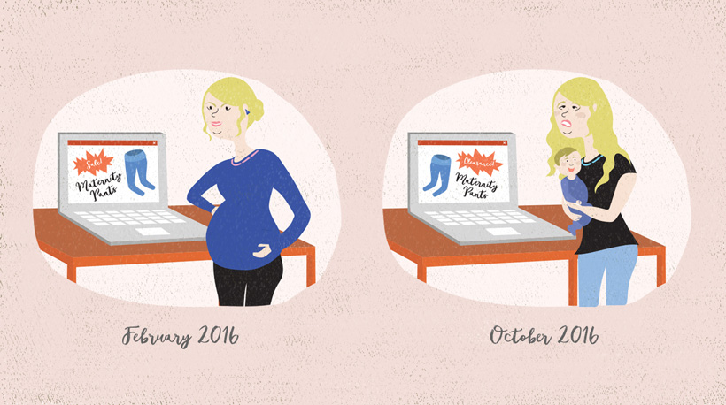
Ramifications of Exposed Data - Benign

Slide 26
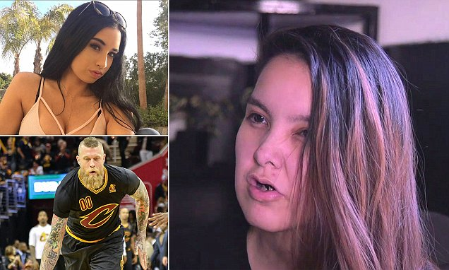
Ramifications of Shared/Exposed Data - Malicious
Aspiring
Model Paris Dunn
Hacker Shelly Cartier
NBA
Player Chris
Andersen
Notes:
put names

Slide 27
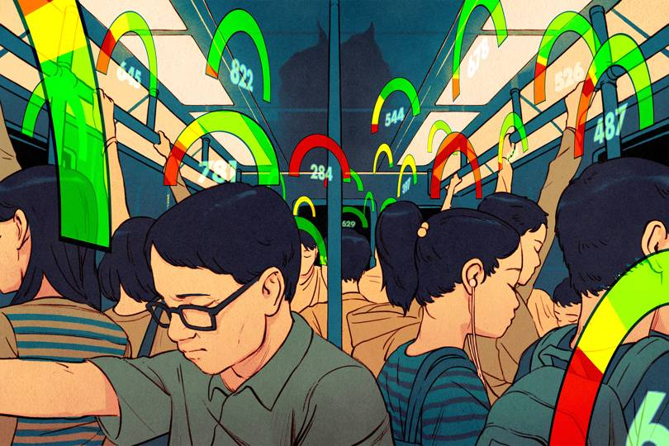
Ramifications of Shared/Exposed Data - Malicious
China Social Credit Score

Slide 28
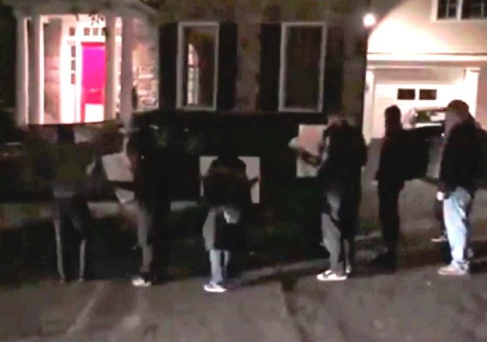
Ramifications of Shared/Exposed Data - Malicious
Antifa in front of Tucker Carlson’s Home

Slide 29
Company wants to find out if there is a link between having a favorite color and income.
Name | Email | Favorite color | weight | income(monthly)
Aaron Dawson | dawson22@gmail.com | Blue | 220 lb | $ 4,000.00 (pfft, I wish)
Becky Morrison | MB2178@gmail.com | Blue | 170 lb | $ 4,400.00
Cole Dickins | Colescoal@yahoo.com | Green | 160 lb | $ 2,000.00
Dave Smith | SmithWithaSilentB@gmail.com | blue | 175 lb | $ 0.00
Emily Sun | DontStareAtTheSun@gmail.com | red | 140 lb | $ 500.00
Fly Eck | ToEckWithIt@yahoo.com | red | 240 lb | $ 700.00
What could you find out about me from such a table?
If given access to this table, what private data would you have?
Are there any trends in the data?

Slide 30
Company wants to find out if there is a link between having a favorite color and income.
Name | Email | Favorite color | weight | income(monthly)
a877dfc76eb | 0188fffaef@gmail.com | Blue | 220 lb | $ 4,000.00
eb89a1121a | 027bae22@gmail.com | Blue | 170 lb | $ 4,400.00
abbb98061a | ff787f320@yahoo.com | Green | 160 lb | $ 2,000.00
abba652219 | a1526f62f@gmail.com | blue | 175 lb | $ 0.00
fa4ff671223 | ff982651b@gmail.com | red | 140 lb | $ 500.00
abb78753f5 | fffe51673@yahoo.com | red | 240 lb | $ 700.00
What could you find out about me from such a table?
If given access to this table, what private data would you have?
Are there any trends in the data?

Slide 31
Collections of data from different sources.
Fave. Color | Income
purple | 2,000
red | 600
blue | 3,200
purple | 2,700
Weight | Income
220 | 2,700
175 | 300
220 | 600
Name | Weight
Aaron | 220
Aaron | 390
Cindy | 250
Debrah | 170
Name | Fave. Color
Aaron | purple
Ben | red
Jane | blue
Kelly | green
Example shows how bringing lots of different data together allows for all encompassing knowledge on an individual.

Slide 32

YOU Must Take Responsibility!
“There are really no consequences” for companies that don’t protect the data other than bad press that gets forgotten about.” - Serge Egelman, a computer security and privacy researcher affiliated with the University of California, Berkeley

Slide 33
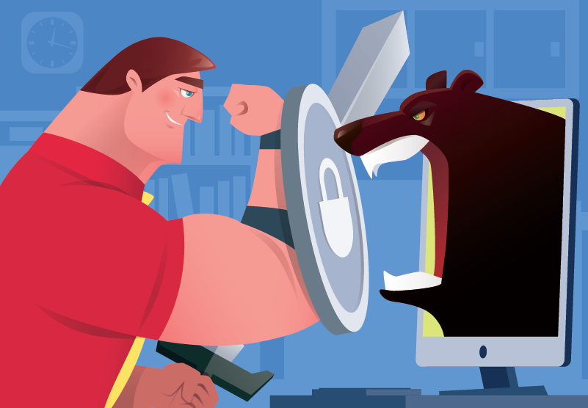
How to Protect Your Data?
Passwords
Put on all devices
Make sure they are strong (Follow website guidelines)
Change regularly
Avoid Free Wi-Fi
Close inactive online accounts
Check your privacy and sharing settings on all social media accounts
https://medium.com/@the_manifest/data-privacy-concerns-an-overview-for-2019-2ccea79aa6f8

Slide 34
Questions?

Slide 35
Sources/Further Research
https://www.fastcompany.com/3036573/nyc-taxi-data-blunder-reveals-which-celebs-dont-tip-and-who-frequents-strip-clubs
https://mrslja.com/data-collection-capabilities/
https://gizmodo.com/heres-all-the-data-collected-from-you-as-you-browse-the-1820779304
https://www.merriam-webster.com/dictionary/monetization
https://www.iab.com/wp-content/uploads/2019/05/Full-Year-2018-IAB-Internet-Advertising-Revenue-Report.pdf
https://www.imdb.com/title/tt0265298/
https://www.denverpost.com/2015/10/28/woman-who-catfished-chris-birdman-andersen-online-sentenced-to-jail/
https://www.businessinsider.com/china-social-credit-system-punishments-and-rewards-explained-2018-4/
https://www.usatoday.com/story/news/politics/2018/11/08/mob-tucker-carlsons-home-antifa-break-door-chant-fox-host/1927868002/
https://medium.com/@the_manifest/data-privacy-concerns-an-overview-for-2019-2ccea79aa6f8

